Slide 1
FTTH Planning and Design

Slide 2

Contents
Table of Contents for FHHT Planning and Design module:
  Executive Summary
Introduction
Project Scope and Objectives
  How Optical Fiber Is Made
  Fiber Design
  How Fiber Works
  Fiber Types
  Refraction & Reflection
  Optical Fiber Parameters
  Frequency
  Attenuation
  Scattering
  Absorption
  Dispersion

Slide 3

Executive Summary
  Purpose of the Document
  Key Objectives
  Summary of Findings
Introduction
  Overview of FHHT (Fiber to the Home Technology)
  Importance of Planning and Design
  Document Structure
Project Scope and Objectives
  Geographic Coverage
  Target Users and Services
  Expected Outcomes
Feasibility Study
  Assessment of Existing Infrastructure
  Environmental and Terrain Analysis
  Cost-Benefit Analysis
  Challenges and Constraints
Bill of Materials (BOM) and Costing
  Detailed Material List
  Cost Estimation and Budgeting
  Vendor and Supplier Selection
Survey and Data Collection
  Field Survey Process
  Mapping and GIS Data
  Infrastructure and Obstruction Assessment
  Network Planning
  Topology Selection (e.g., Point-to-Point, GPON, or EPON)
  Primary and Secondary Fiber Routes
  Placement of Network Elements (e.g., OLTs, Splitters, ONTs)
  Scalability and Redundancy
Capacity Planning and Bandwidth Allocation
  Estimation of Initial and Future Demand
  Splitter Ratios and Distribution Points
  Bandwidth Allocation per User
Design Considerations
  Fiber Type and Specifications
  Layout of Ducts, Poles, and Trenches
  Design of Active and Passive Components
  Compliance with Industry Standards

Slide 4
Implementation Plan
  Phased Rollout Strategy
  Resource and Workforce Allocation
  Installation Guidelines
  Safety and Compliance
Risk Assessment and Mitigation Strategies
  Potential Risks in Deployment
  Mitigation Plans for Identified Risks
Testing and Validation
  Network Design Simulations
  Pilot Testing and Field Trials
  Performance Metrics and KPIs
Documentation and Reporting
  Design and Planning Documentation
  Survey and Test Reports
  Approval Processes
Monitoring and Feedback
  Continuous Monitoring of Network Performance
  Stakeholder Feedback Mechanisms
  Updates to Design Based on Findings

Slide 5
Executive Summary
The Fiber to the Home Technology (FHHT) Planning and Design Document outlines a comprehensive approach to developing a reliable and efficient fiber-optic network. This document serves as a blueprint for deploying a scalable, cost-effective, and high-performance broadband infrastructure tailored to meet the growing demands of modern connectivity.
Purpose of the Document
This document’s primary goal is to provide a structured plan and design framework for implementing FHHT in the designated project area. It addresses key considerations such as feasibility, network topology, material requirements, and risk management to ensure successful deployment.
Key Objectives
Efficient Network Design: Create an optimized and scalable fiber network to serve both current and future user demands.
Cost-Effectiveness: Minimize project costs while maintaining high-quality service and infrastructure.
Regulatory Compliance: Adhere to all industry standards, environmental regulations, and local permitting requirements.
User-Centric Approach: Ensure the network design aligns with end-user requirements for bandwidth, reliability, and speed.

Slide 6


Survey and Data Collection
Survey and data collection are critical steps in the planning and design process for an FHHT (Fiber to the Home Technology) project. This phase ensures accurate information is gathered about the project area to guide network design, cost estimation, and implementation planning

Slide 7
Objectives of the Survey
Identify Optimal Fiber Routes: Determine the best paths for laying fiber, avoiding obstructions, and minimizing costs.
Assess Existing Infrastructure: Document usable poles, ducts, conduits, and other assets that can reduce project expenses.
Gather Environmental Data: Understand terrain, weather conditions, and potential environmental challenges.
Confirm Regulatory and Permission Requirements: Identify areas needing permits, right-of-way (RoW) agreements, or special approvals.

Slide 8
DATA TO BE COLLECTED
Geographical Data:
  Coordinates key locations such as Optical Line Terminal (OLT) sites, splitter locations, and customer premises.
  Elevation data for planning routes across varied terrains.
Existing Infrastructure:
  Inventory of available poles, conduits, manholes, and cabinets.
  Condition and capacity of existing infrastructure.
Environmental Data:
  Identification of water bodies, forests, or other natural barriers.
  Weather patterns that may affect installation and maintenance.
Regulatory and Legal Data:
  Locations requiring RoW agreements or permits.
  Areas with zoning restrictions or environmental protection regulations.

Slide 9
FTTH Survey Tools and Techniques
Fiber to the Home (FTTH) survey tools and techniques are critical for efficiently planning and deploying fiber optic networks. Here’s an overview of the tools and techniques involved in an FTTH survey:
Measuring Wheel
  Used to measure distances along potential cable routes.
  It is useful for calculating the total fiber length required.
Laser Range Finder
  Measures distances and heights, especially for overhead installations.
  Helps in identifying the height of poles and other obstacles.
GPS Device
  Captures accurate geographical coordinates of survey points.
  Assists in mapping routes and integrating them into GIS software.
GIS Software
  Maps the surveyed area to identify the best routes for the fiber.
  Allows for detailed planning of network infrastructure.
Digital Camera or Smartphone
  Captures images of the site for documentation purposes.
  Useful for recording the condition of poles, manholes, and other infrastructure.

Slide 10
Network Planning
Network planning is a critical phase in FHHT (Fiber to the Home Technology) deployment, as it establishes the blueprint for creating an efficient, scalable, and reliable fiber-optic network. This phase involves selecting the network topology, designing routes, and determining key components to meet current and future demands.
Objectives of Network Planning
Develop an optimal network topology for seamless data flow.
Ensure scalability to accommodate future user growth and technological advancements.
Minimize deployment and maintenance costs while maximizing reliability and performance.
Key Components of Network Planning
Network Topology Selection:
Point-to-Point (P2P): Direct connection between the Optical Line Terminal (OLT) and the end-user. Suitable for high-demand users but less cost-efficient for large-scale deployment.
Passive Optical Network (PON): Uses optical splitters to share a single fiber connection among multiple users. GPON (Gigabit Passive Optical Network) is commonly used for its cost-efficiency and scalability.
Primary and Secondary Fiber Routes:
Plan primary routes to connect the central office (CO) to major service areas.
Design secondary routes to connect distribution points, such as cabinets and splitters, to end-users.
Ensure route redundancy for reliability and disaster recovery.
Placement of Network Elements:
Optical Line Terminals (OLTs): Installed at the central office to manage fiber connections and distribute data.
Optical Network Terminals (ONTs): Placed at the user premises to convert optical signals into electrical signals for devices.
Splitters: Deployed in strategic locations to distribute a single fiber connection to multiple users.
Connectivity and Bandwidth Allocation:
Define the split ratio (e.g., 1:32 or 1:64) based on user density and bandwidth requirements.
Allocate bandwidth per user to meet service-level agreements (SLAs).

Slide 11
Design Considerations
Fiber Type:
Single-mode fiber is recommended for long-distance and high-speed connections.
Multi-mode fiber may be used for shorter distances but is less common in FHHT deployments
Environmental Factors:
  Consider terrain, weather, and urban density when designing routes.
  Plan for underground, aerial, or hybrid deployment based on area-specific conditions.
Compliance with Standards:
Follow ITU-T, IEEE, and local regulatory standards for fiber installation and safety.
Future-Proofing:
Design the network to support upcoming technologies, such as 10G PON or WDM-PON.
Plan for easy upgrades by incorporating spare capacity in fiber ducts and splitters.

Slide 12
Tools and Software for Planning
• Geographic Information System (GIS): For mapping routes, analyzing terrain, and visualizing coverage.
• Network Design Software: Tools like AutoCAD, Visio, or specialized fiber design platforms to create detailed network layouts.
• Simulation Tools: To test network performance, redundancy, and scalability.

Slide 13
Capacity Planning and Bandwidth Allocation
Capacity planning and bandwidth allocation are essential components of the FHHT (Fiber to the Home Technology) design process. These steps ensure that the fiber-optic network can handle current user demands while also supporting future growth and maintaining optimal performance. The goal is to design a network that balances resource utilization, avoids bottlenecks, and provides a seamless user experience.
Objectives of Capacity Planning and Bandwidth Allocation
Efficient Resource Utilization: Ensure the network is not over- or under-provisioned in terms of bandwidth, leading to optimal performance and cost-efficiency.
Future Scalability: Design the network to handle increasing demand from end-users and new technologies.
Quality of Service (QoS): Ensure that sufficient bandwidth is available for all users while maintaining high service quality, especially for bandwidth-intensive applications like video streaming, gaming, and cloud services.
Minimize Latency and Congestion: Avoid network congestion and latency by planning adequate bandwidth for peak usage times.

Slide 14
Factors Affecting Capacity Planning
User Demand and Growth Projections:
  Current User Base: Assess the number of users in the project area, including residential, commercial, and industrial customers.
  Future Growth: Project future increases in users, bandwidth demand, and technological trends (e.g., smart homes, 5G, IoT).
  Usage Patterns: Consider peak usage times, such as evenings when users are most active, and the types of activities (e.g., HD video streaming, online gaming).
Available Fiber Resources:
  Fiber Capacity: Determine how many fibers can be deployed and how they will be utilized for different purposes (e.g., trunk lines, distribution, and user connections).
  Bandwidth per Fiber: Evaluate the bandwidth that each fiber type can support (e.g., single-mode fiber typically supports higher bandwidths over longer distances than multi-mode fiber).

Slide 15
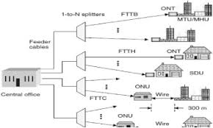
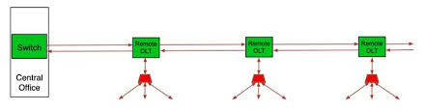
Network Topology and Design:
PON Design: In Passive Optical Networks (PON), the split ratio affects the capacity. For example, a 1:32 splitter means a single fiber can serve up to 32 users, but bandwidth is shared.
Redundancy and Failover: Plan for backup capacity in case of network failures or outages.
FTTH Network Topologies:
Point-to-Point (P2P) Topology:
Each home is connected directly to the central office (CO) or local exchange via a dedicated fiber optic line.
Passive Optical Network (PON) Topology:
Utilizes unpowered (passive) optical splitters to divide a single fiber from the CO among multiple homes.

Slide 16
Bill of Materials (BOM) and Costing
The Bill of Materials (BOM) and costing section is critical for planning and executing an FHHT (Fiber to the Home Technology) project. It provides a detailed list of all materials, equipment, and resources required for deployment, along with their associated costs. This information is essential for budgeting, procurement, and project execution.
Objectives of BOM and Costing
Identify all required materials and equipment for network deployment.
Provide an accurate cost estimate for project planning and approval.
Enable efficient procurement and inventory management.
Ensure cost-effectiveness while maintaining quality and scalability
Components of BOM:
Fiber-Optic Cables
Passive Components
Active Components
Supporting Infrastructure

Slide 17
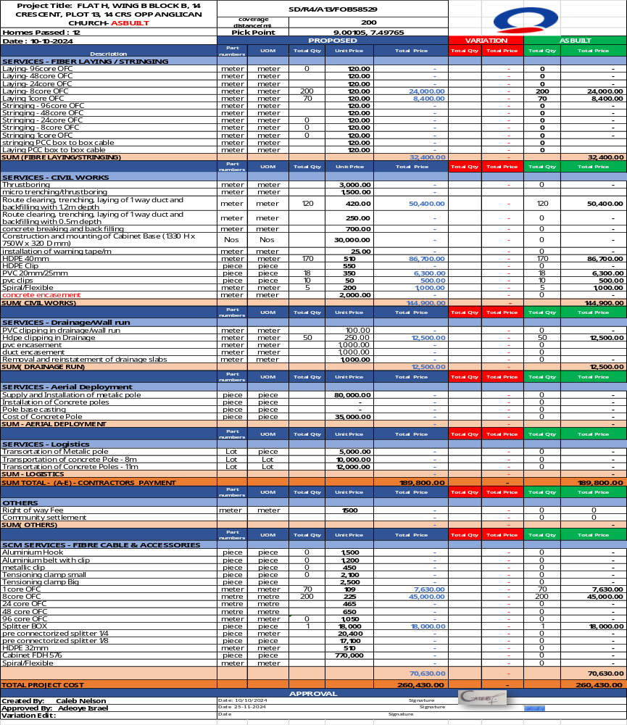

Slide 18
Cost Optimization Strategies
Vendor Selection:
  Negotiate bulk discounts with suppliers for materials and equipment.
  Choose vendors that provide both quality and cost-efficiency.
Standardization:
  Use standardized components to reduce costs and simplify maintenance.
Efficient Design:
  Optimize fiber routes and split ratios to minimize material usage.
  Avoid over-provisioning while ensuring scalability.
Local Labor and Resources:
  Utilize local contractors and resources to reduce labor and transportation costs.
Reuse of Existing Infrastructure:
  Leverage existing poles, ducts, and conduits where possible to reduce deployment costs.
A detailed BOM and accurate costing are essential for the successful planning and execution of an FHHT project. By carefully estimating material, labour, and operational costs, the project

Slide 19
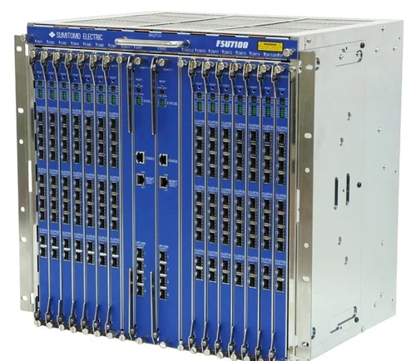


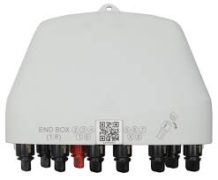
FTTH NETWORK COMPONENTS:
Optical Line Terminal (OLT)
Optical Splitters

Slide 20
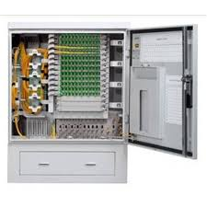


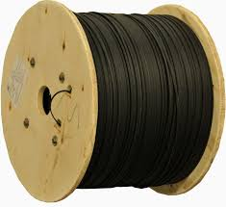

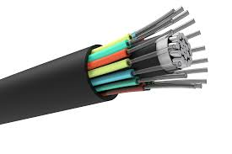
Optical Distribution Frame(Cabinet)
Optical Network Terminal (ONT) / Optical Network Unit (ONU)
Optical Distribution Network (ODN)
Fiber Optic Cables

Slide 21
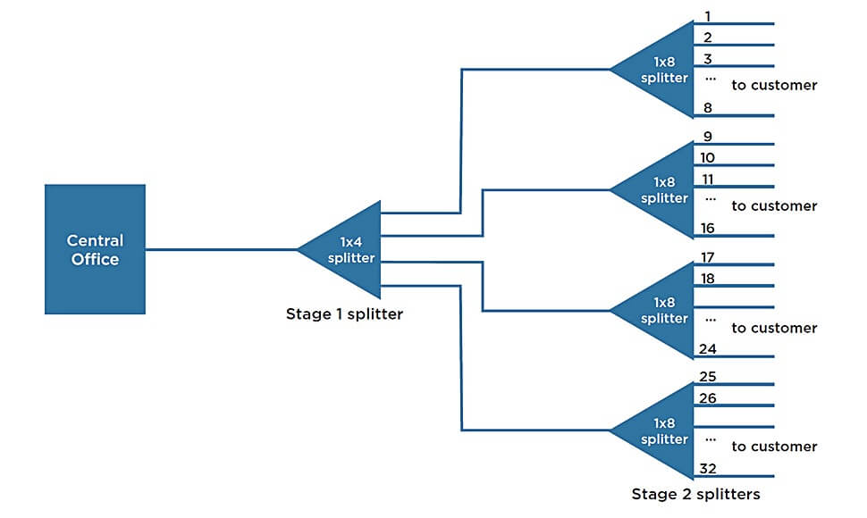
FTTH DISTRIBUTION

Slide 22
THANK YOU

